Slide 1
QEP Update
Presented at the Academic Affairs Meeting
August 22, 2016
Eileen DeLuca
Scott VanSelow

Slide 2
QEP Goals
Primary Goal
Enable first-time-in-college students to become self-reliant learners imbued with critical thinking skills.
Student Outcomes
Facilitate an increase in student retention rates, rates of persistence, and graduation rates.
Foster increased rates of student satisfaction and student engagement.
Faculty and Staff Outcomes
Apply newly obtained knowledge to their practices to promote critical thinking and enhance the likelihood of success for first-year students.

Slide 3
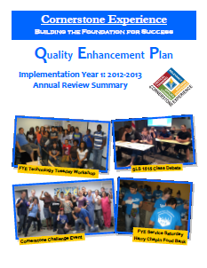
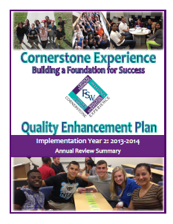
Annual report and Summary

Slide 4
From QEP to completion
2016-2017 is the fifth year of QEP Implementation
QEP Goals help support the “Dedicate to Graduate” Initiative
Cornerstone Course and program will continue to evolve based on assessment and regular faculty-driven curricular revision.

Slide 5
What We Know
There is a relationship between Cornerstone course participation and
  retention
  student engagement
  critical thinking skills
Visit http://www.fsw.edu/fye/qep/assessment
to review annual reports.

Slide 6
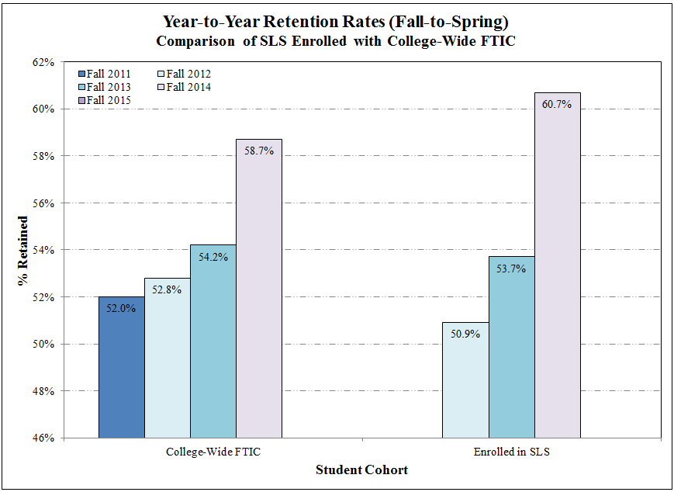
QEP: Tracking Retention

Slide 7
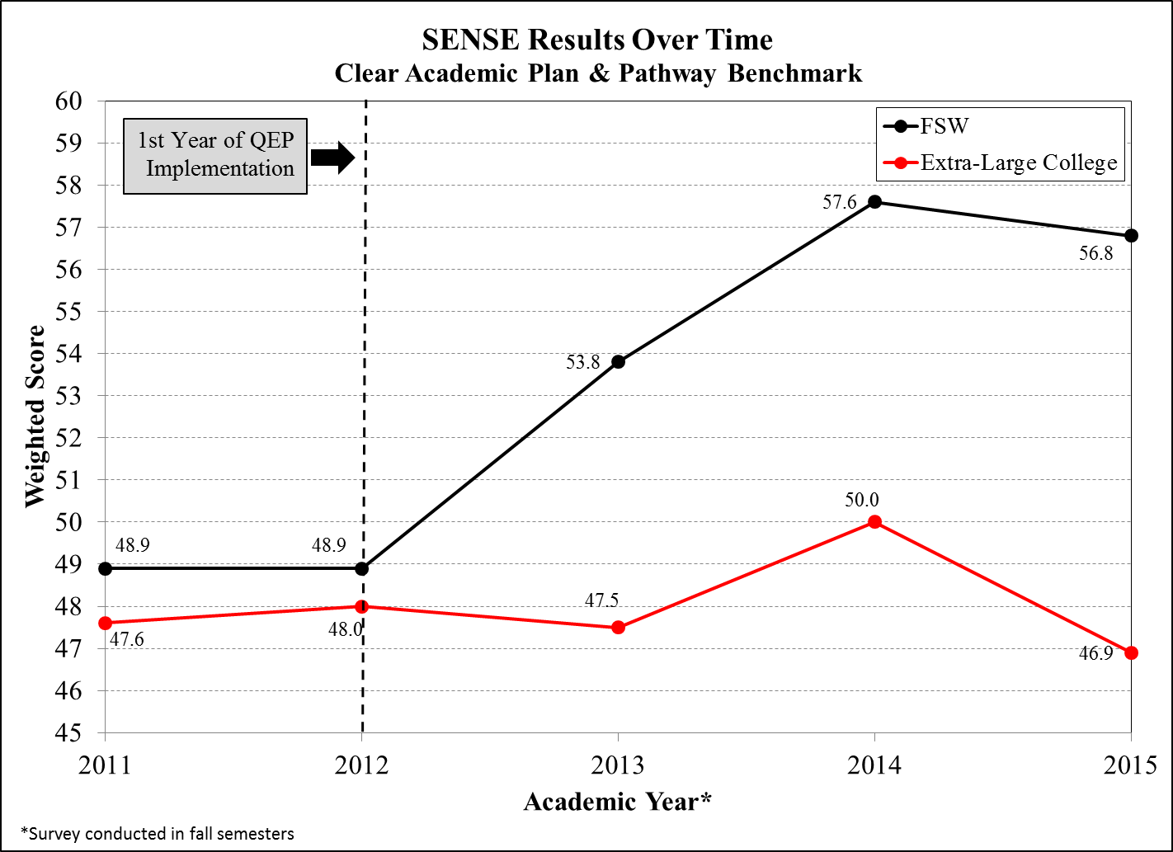
QEP: Student Engagement

Slide 8
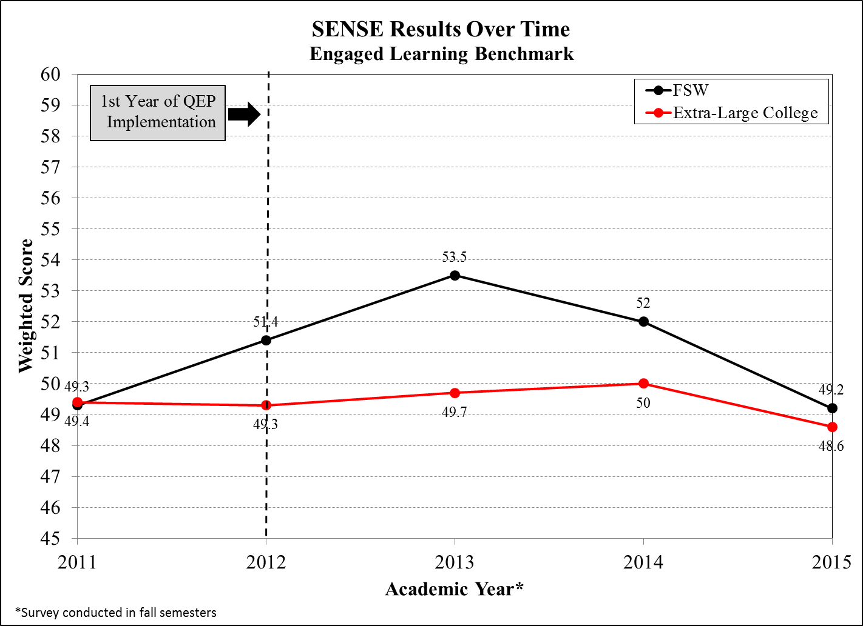
QEP: Student Engagement

Slide 9
During the first three weeks of your first semester at this college, how often did you:
Discuss an assignment or grade with an instructor
Ask for help from an instructor regarding questions or problems related to a class
Receive prompt written or oral feedback from instructors on your performance
Discuss ideas from readings or classes with instructors outside of class
Use face-to-face tutoring
Use writing, math, or other skill lab
http://www.ccsse.org/sense/aboutsense/

Slide 10
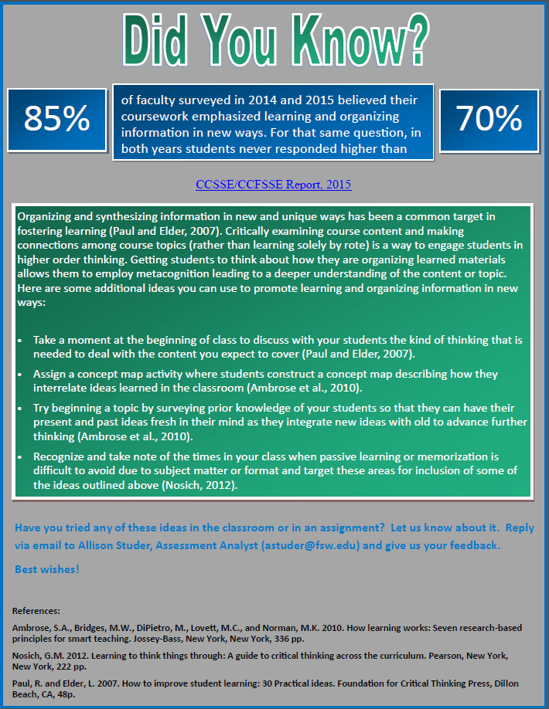

Slide 11
Engendering Student Scholars

Slide 12
How many of you have received a Student email like the following…
Sent: Tue 11/13/2012 9:56 PM
I don't know my canvas password and i lost my id today and i have my journal ready to send in beacuse i did it before but now i cant send it to you should i just send it to youi in a message?

Slide 13
Students as Scholars
Explicitly stating expectations for scholarly work.
  Students are expected to follow stated guidelines for format and content in their writing assignments.
    Critical Thinking Journal
    Final Essay

Slide 14
Students as Scholars
  Scholarly Communication in Higher Education
    Students are expected to behave in a manner that is responsible and respectful. They are reminded that they may be interacting with a future professor, employer, or professional contact. Their behavior should impress upon others that they are a college student, scholar, and good citizen.
      Visiting a faculty member during office hours.
      Navigating college services and events.

Slide 15
Students as Scholars
  Developing Academic Technology Skills
    Students are expected to employ academic technology to complete assignments.
      Canvas submission for assignments
      Projects employing multimedia

Slide 16
Training and Development

Slide 17
:
Training Module Completers
As of August 2015, 181 faculty and staff have completed the ten Cornerstone Instructor Training Modules.
739 faculty/staff have completed one or more QEP Cornerstone Modules.
120 faculty and staff attended the 2015 Cornerstone Summer Training Institute.
All departments are encouraged to set training completion goals in the 2016-2017 Unit Plans.
Notes:
Kathy

Slide 18
Training Feedback
Critical Thinking:
Very Very engaging instructors!! The content is very applicable across the board (life, work etc.). This an important area to emphasize for new students at the college--and everyone really.
Understanding the First-Year Student:
This will improve my ability to effectively communicate with this student population.
The Way I Learn:
Applicable in all levels of communication both at work and in life. Added to a deeper understanding of my strengths and weaknesses with regards to learning.

Slide 19

  Thank you for all you do to support first-year students!
http://www.fsw.edu/fye/cornerstone

